Slide 1
Views, Indexes and JDBC/JSP tutorial
Professor: Dr. Shu-Ching Chen
TA: Haiman Tian

Slide 2
Outline
Introduction of Views
Introduction of Indexes
Instruction to access PostgreSQL from Tomcat
Setup Tomcat in your Unix account
Write down the info output by the script
Copy jdbc to the common/lib folder of tomcat
Create a jsp page to access your PostgreSQL database
JDBC

Slide 3
Views (1)
A selective presentation of the structure of, and data in, one or more tables (or other views)
A ‘virtual table’, having predefined columns and joins to one or more tables, reflecting a specific facet of information
Structure data in a way that users or classes of users find natural or intuitive.
Restrict access to the data such that a user can only see limited data instead of complete table.
Summarize data from various tables which can be used to generate reports.
Notes:
useful if you have an expensive query against data that doesn't change much.
Views are named, stored queries in the database, which are called and executed each time the view is included in a query to the database.
The difference between table and MV is with table , you can do DML operations which will be seen by other users whereas the changes you do to MV will not be available to others until you update your database server.
MV has another advantage when you build MV based on multiple tables using complex queries, the users when using MV the performance increases drastically.
Views are pseudo-tables. That is, they are not real tables, but nevertheless appear as ordinary tables to SELECT. A view can represent a subset of a real table, selecting certain columns or certain rows from an ordinary table. A view can even represent joined tables. Because views are assigned separate permissions, you can use them to restrict table access so that users see only specific rows or columns of a table.
A view can contain all rows of a table or selected rows from one or more tables. A view can be created from one or many tables which depends on the written PostgreSQL query to create a view.
Views, which are kind of virtual tables, allow users to do the following:
Structure data in a way that users or classes of users find natural or intuitive.
Restrict access to the data such that a user can only see limited data instead of complete table.
Summarize data from various tables which can be used to generate reports.
Because views are not ordinary tables, so you may not execute a DELETE, INSERT, or UPDATE statement on a view. But you can create a RULE to correct this problem of using DELETE, INSERT or UPDATE on a view.

Slide 4
Views (2)
CREATE OR REPLACE VIEW is similar
If a view of the same name already exists, it is replaced
The new query must generate the same columns that were generated by the existing view query (that is, the same column names in the same order and with the same data types)
It may add additional columns to the end of the list. The calculations giving rise to the output columns may be completely different.
If a schema name is given (for example, CREATE VIEW myschema.myview ...) then the view is created in the specified schema. Otherwise it is created in the current schema.

Slide 5
Views (3)
TEMPORARY or TEMP
Temporary views are automatically dropped at the end of the current session.
Existing permanent relations with the same name are not visible to the current session while the temporary view exists, unless they are referenced with schema-qualified names.
If any of the tables referenced by the view are temporary, the view is created as a temporary view (whether TEMPORARY is specified or not).

Slide 6
Views (4)
Temporary views exist in a special schema, so a schema name cannot be given when creating a temporary view.
The name of the view must be distinct from the name of any other view, table, sequence, index or foreign table in the same schema.

Slide 7
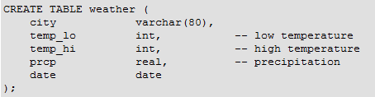

Example
CREATE VIEW myview AS
SELECT city, temp_lo, temp_hi, prcp, date, location
FROM weather, cities
WHERE city = name;
SELECT * FROM myview;
DROP VIEW myview;
Notes:
Suppose the combined listing of weather records and city location is of particular interest to your application, but you do not want to type the query each time you need it. You can create a view over the query, which gives a name to the query that you can refer to like an ordinary table
Making liberal use of views is a key aspect of good SQL database design. Views allow you to encapsulate the details of the structure of your tables, which might change as your application evolves, behind consistent interfaces.
Views can be used in almost any place a real table can be used.

Slide 8

Indexes

Slide 9
Indexes
Primary mechanism to get improved performance
on a database
Persistent data structure, stored in database
Many interesting implementation issues
Notes:
Indexes are a common way to enhance database performance. An index allows the database server to find and retrieve specific rows much faster than it could do without an index. But indexes also add overhead to the database system as a whole, so they should be used sensibly.

Slide 10
Functionality
T
Index
on T.A
 | A | B | C
1 | cat | 2 | …
2 | dog | 5 | …
3 | cow | 1 | …
4 | dog | 9 | …
5 | cat | 2 | …
6 | cat | 8 | …
7 | cow | 6 | …
 | … | … | …
T.A = ‘cow’
T.A = ‘cat’
Notes:
String column with animal’s name
without scanning the entire table

Slide 11
Functionality
T
Index
on T.A
 | A | B | C
1 | cat | 2 | …
2 | dog | 5 | …
3 | cow | 1 | …
4 | dog | 9 | …
5 | cat | 2 | …
6 | cat | 8 | …
7 | cow | 6 | …
 | … | … | …
T.B = 2
Index
on T.B
T.B < 6
4< T.B <= 8

Slide 12
Functionality
T
Index
on T.A
 | A | B | C
1 | cat | 2 | …
2 | dog | 5 | …
3 | cow | 1 | …
4 | dog | 9 | …
5 | cat | 2 | …
6 | cat | 8 | …
7 | cow | 6 | …
 | … | … | …
T.A = ‘cat’
and T.B > 5
Index
on T.(A,B)
Index
on T.B
T.A < ‘d’
And T.B = 1
Notes:
How index help user to go directly to the tuple which satisfied the condition rather than scan the entire table

Slide 13
Utility
Index = difference between full table scans and
immediate location of tuples
Orders of magnitude performance difference
Underlying data structures
Balanced trees (B trees, B+ trees)
Hash tables
A=V, A<V,
V1< A < V2
A=V
Notes:
Balanced trees are certainly more flexible
The operation of
Only equality condition are to be used then the hash table index might be preferred
Hash-based indexes are best for equality selections. They do not support efficient range searches.

Slide 14
Select sName
From Student
Where sID = 18942
Index on sID
Many DBMS’s build indexes automatically on
PRIMARY KEY (and sometime UNIQUE)attributes
Notes:
The index will allow the query execution pretty much straight to that tuple, without the index the entire student table will need to be scanned

Slide 15
Select sID
From Student
Where sName = ‘Mary’ And GPA > 3.9
Index on sName
Hash-based or Tree-based
Index on GPA
Tree-based
Index on (sName, GPA)
Notes:
Simultaneously find

Slide 16
Downsides of Indexes
1)
2)
3)
Extra space
- Marginal
Index creation
- Medium
Index maintenance
- Can offset benefits
Notes:
From least severe to most severe
They do taka an extra space since they are persistent data structure, resided with data. Even, they can potentially double the database.
It’s not big of deal toward today’s situation
Fairly time consuming operation so we considered it as medium downside. On the other hand, once the indexes created all the query run faster so usually it is worthwhile to do it
Index is the data structure helps answering query
When the value in the database change, then the index has to be modified to reflect those changes
If the database is modified frequently then each modification is going to be significantly slower than if we did not have indexes
If the database is modified a whole bunch and not query that often
The cost of index maintenance may offset the benefit of having indexes

Slide 17
Picking which indexes to create
Benefit of an index depends on:
Size of table (and possibly layout)
Data distributions
Query vs. update load
Notes:
How big the table is, since the index help us to find specific portion of table quickly
Because the index help us to find specific data value quickly
How often we are going to query the database and how often we are going update it

Slide 18
SQL Syntax
Create Index IndexName on T(A)
Create Index IndexName on T(A1,A2,…,An)
Create Unique Index IndexName on T(A)
Drop Index IndexName
Notes:
Creates a unique index on a table. Duplicate values are not allowed

Slide 19
Outline
Introduction of Views
Introduction of Indexes
Instruction to access PostgreSQL from Tomcat
Setup Tomcat in your Unix account
Write down the info output by the script
Copy jdbc to the common/lib folder of tomcat
Create a jsp page to access your PostgreSQL database
JDBC
Notes:
Apache Tomcat (or simply Tomcat, formerly also Jakarta Tomcat) is an open source web server and servlet container developed by the Apache Software Foundation (ASF). Tomcat implements the Java Servlet and the JavaServer Pages (JSP) specifications from Oracle Corporation, and provides a "pure Java" HTTP web server environment for Java code to run.

Slide 20
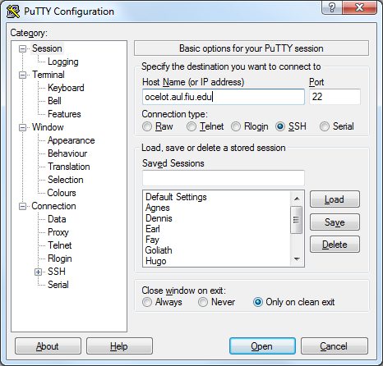
(1) Setup Tomcat in your Unix account
Log into ocelot.aul.fiu.edu by using putty through ssh

Slide 21
(1) Setup Tomcat in your Unix account
Log into ocelot.aul.fiu.edu
User : FIU account
Password : Your first initial, followed by your Panther ID, followed by your last initial.
Make sure your JAVA_HOME environment variable is set to /depot/J2SE-1.7
Using the tech shell (most users use this)
setenv JAVA_HOME /depot/J2SE-1.7

Slide 22
(1) Setup Tomcat in your Unix account
Run this script
/home/ocelot/tomcat/install-tomcat-cop4710.sh
cd /home/ocelot/tomcat
./install-tomcat-cop4710.sh
Additional instructions will be provided after running this script and it will also tell you which port is assigned to you.
Note that if you do not have your JAVA_HOME environment variable set correctly, you will have problems running Tomcat.

Slide 23
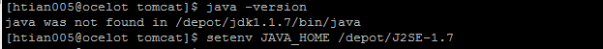
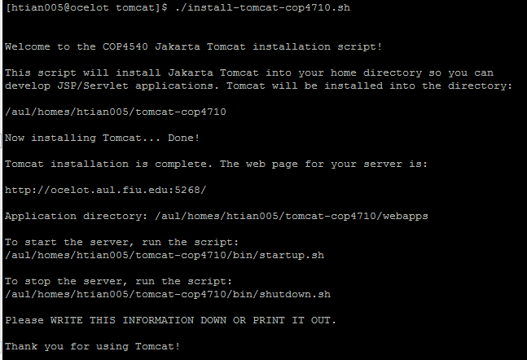

Slide 24
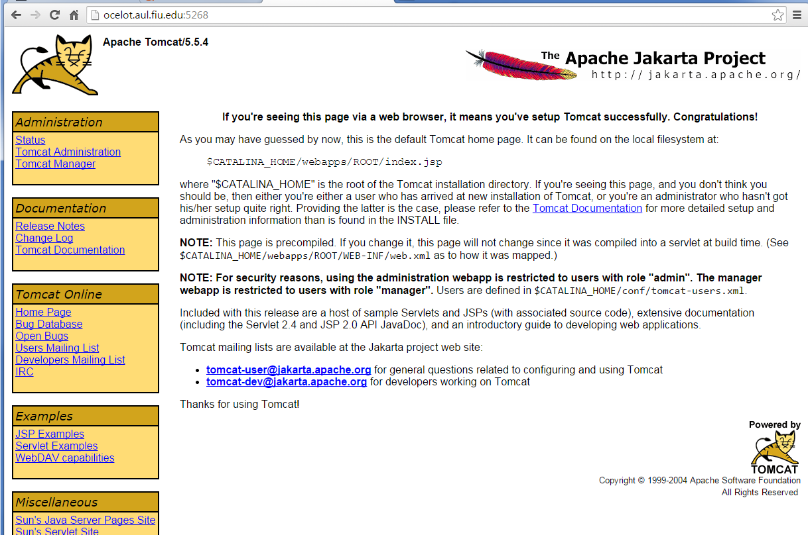
(1) Setup Tomcat in your Unix account
Start Tomcat
. /tomcat-cop4710/bin/startup.sh

Slide 25
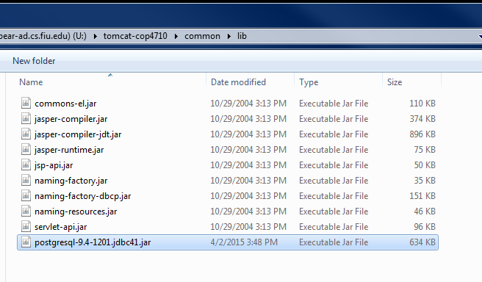
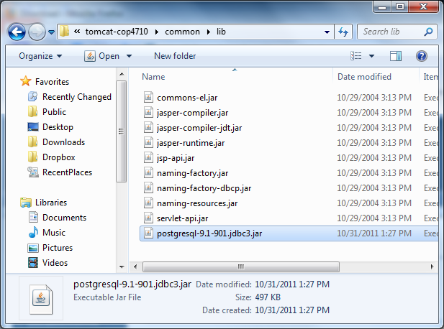
(3) Copy jdbc
Copy jdbc to the common/lib folder of tomcat
Download PostgreSQL JDBC driver from http://jdbc.postgresql.org/

Slide 26
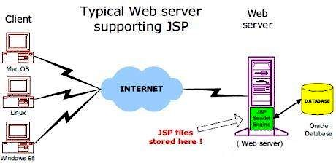
Java Server Pages (JSP)
JSP is a server-side programming technology that enables the creation of dynamic, platform-independent method for building Web-based applications.
JSP have access to the entire family of Java APIs, including the JDBC API to access enterprise databases.

Slide 27
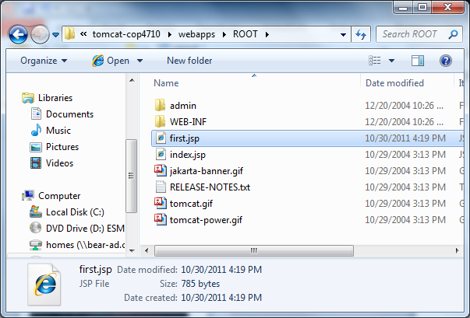
(4) Create a jsp page
Put the file in the ROOT folder in the Application directory

Slide 28
JSP Syntax (1)
A scriptlet can contain any number of JAVA language statements, variable or method declarations, or expressions that are valid in the page scripting language.
HTML tags, or JSP elements you write must be outside the scriptlet:
<% code fragment %>
<html>
<head><title>Hello World</title></head>
<body> Hello World!<br/>
<%
out.println("Your IP address is " + request.getRemoteAddr());
%>
</body>
</html>

Slide 29
JSP Syntax (2)
Use the code from the previous file in JSP file hello.jsp and put this file in
\APACHE_INSTALLATION_PATH\webapps\ROOT
Browse through the same using URL http://localhost:8080/hello.jsp. The above code will generate the following result −

Slide 30
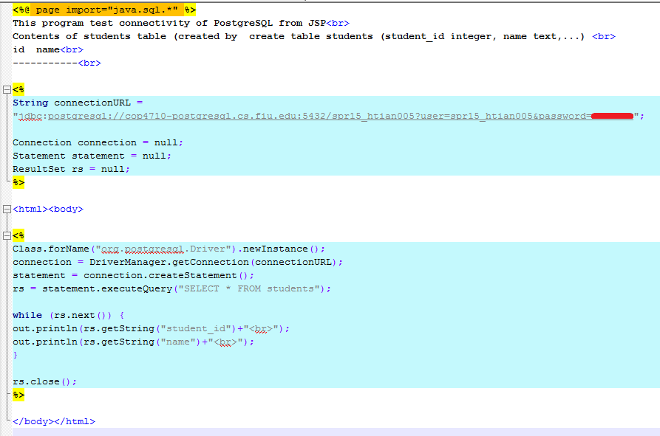
(4) Create a jsp page

Slide 31
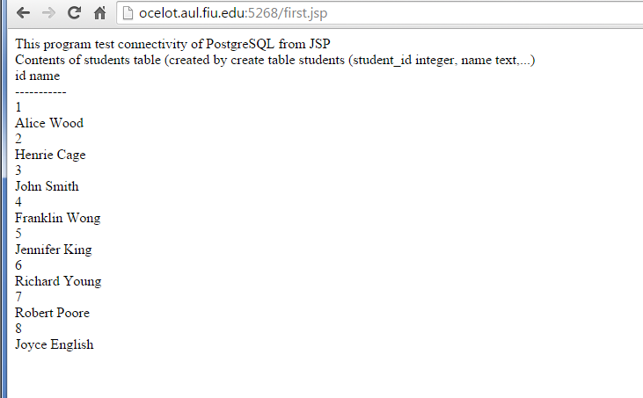
(4) Create a jsp page

Slide 32
JSP – Lifecycle (1)
A JSP life cycle is defined as the process from its creation till the destruction.
Compilation
Initialization
Execution
Cleanup

Slide 33
JSP – Lifecycle (2)
Compilation:
When a browser asks for a JSP, the JSP engine first checks to see whether it needs to compile the page.
If the page has never been compiled, or if the JSP has been modified since it was last compiled, the JSP engine compiles the page.
Compilation process:
Parsing the JSP
Turning the JSP into a servlet
Compiling the servlet

Slide 34
JSP – Lifecycle (3)
Initialization:
If you need to perform JSP-specific initialization, override the jspInit() method
public void jspInit(){
// Initialization code...
}

Slide 35
JSP – Lifecycle (4)
Execution:
This phase of the JSP life cycle represents all interactions with requests until the JSP is destroyed.
Whenever a browser requests a JSP and the page has been loaded and initialized, the JSP engine invokes the _jspService()method in the JSP.
The _jspService() method takes an HttpServletRequest and an HttpServletResponse as its parameters as follows
void _jspService(HttpServletRequest request, HttpServletResponse response) {
// Service handling code...
}

Slide 36
JSP – Lifecycle (5)
Cleanup:
The destruction phase of the JSP life cycle represents when a JSP is being removed from use by a container.
The jspDestroy() method is the JSP equivalent of the destroy method for servlets.
Override jspDestroy when you need to perform any cleanup, such as releasing database connections or closing open files.
public void jspDestroy() {
// Your cleanup code goes here.
}

Slide 37
Outline
Introduction of Views
Introduction of Indexes
Instruction to access PostgreSQL from Tomcat
Setup Tomcat in your Unix account
Write down the info output by the script
Copy jdbc to the common/lib folder of tomcat
Create a jsp page to access your PostgreSQL database
JDBC

Slide 38
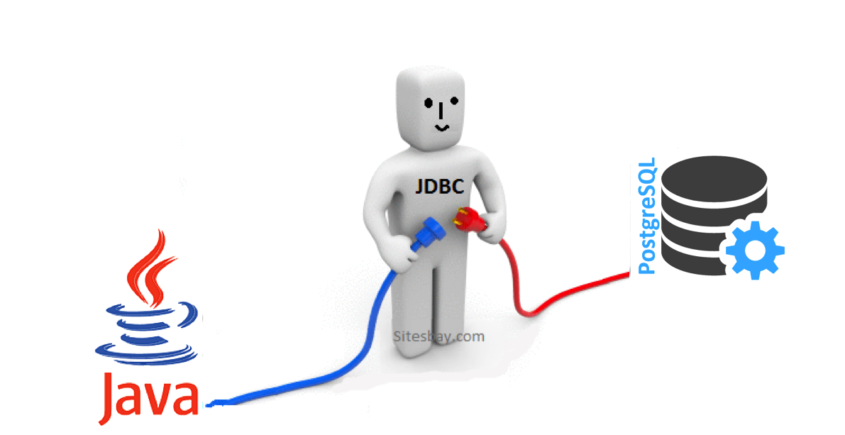
JDBC
JDBC API is a Java API that can access the data stored in a Relational Database
Notes:
JDBC is a Java-based data access technology
This technology is an API for the Java programming language that defines how a client may access a database.
JDBC is oriented towards relational databases.

Slide 39
JDBC
Write once, Match all DBMS!!
The Java Database connectivity
Making a connection to a database
Creating SQL or MySQL statements
Executing queries in the database
Viewing or Modifying the result records
Oracle Database
JDBC
Driver
Interface
Oracle JDBC Driver
Application
SQL JDBC Driver
SQL Database
MySQL JDBC Driver
MySQL Database
PostgreSQL JDBC Driver
PostgreSQL Database
Notes:
JDBC is a Java-based data access technology
This technology is an API for the Java programming language that defines how a client may access a database.
JDBC is oriented towards relational databases.

Slide 40
Steps of connecting database
Get the specific type of JDBC driver
Initializing the Driver
Start the Connection
Initialize one Statement object
Send out the SQL execute*()
Get the Resultset object which is returned by DBMS
Close the connection close()

Slide 41
(1) Get JDBC driver
Download driver from any DBMS company website
Format: <DBMS_Name-JDBC-Type_n.jar>
For example: postgresql-9.4-1201.jdbc4.jar
Put it to any accessible library folder
PostgreSQL JDBC Driver : http://jdbc.postgresql.org

Slide 42
(2) Initializing the Driver
Importing JDBC
Import java.sql.*
Loading the server
Class.forName("org.postgresql.Driver");
try {
Class.forName("org.postgresql.Driver");
} catch (ClassNotFoundException e) {
System.out.println(“Can’t find Driver class ");
}

Slide 43
(3) Start the connection
String DRIVER = "org.postgresql.Driver"; String URL ="jdbc:postgresql://[IP]:5432/[DB_Name]"; String USER = "whoami"; String PASSWORD = "123456";
Connection conn = DriverManager.getConnection( URL, USER, PASSWORD );
// DriverManager.getConnection( url ); System.out.println(conn.isReadOnly( )); ...
if ( conn != null && !conn.isClosed( ) ) { System.out.println(“Successfully connect to database！"); } conn.close( );

Slide 44
(4) Initialize one Statement object and (5)execute
Execute
executeQuery() -> SQL for Searching and viewing
executeUpdate() -> SQL for Changing database’s contents
ExecuteQuery()
Return results as row(s)
Use next() to move to next record, return a boolean value to indicate whether we have next record
Use get<Type>() to retrieve the data by attribute name or order
Statements stmt = conn.createStatement( );
ResultSet result = stmt.executeQuery(“SELECT * FROM myTable”);

Slide 45
Execute Example
Create / Update table
View data
Statements stmt = conn.createStatement( );
stmt.executeUpdate( "CREATE TABLE jdemo ( title character varying(50),body text, id serial)");
stmt.executeUpdate(“ALTER TABLE jdemo ADD PRIMARY KEY (id)”);
ResultSet result =
stmt.executeQuery(“SELECT * FROM jdemo”); while (result.next( )) { System.out.print(result.getInt(“id”) + “\t”); System.out.print(result.getString("title") + "\t"); System.out.println(result.getString("body")); }

Slide 46
Execute Example
Insert Record
Delete Record
Statements stmt = conn.createStatement( );
String sql = "INSERT INTO User" + "VALUES (100, 'Zara', 'Ali', 18)"; stmt.executeUpdate(sql);
Statements stmt = conn.createStatement();
String sql = "DELETE FROM User" + "WHERE id = 101";
stmt.executeUpdate(sql);

Slide 47
Data Types
SQL | JDBC/Java | setXXX | updateXXX
VARCHAR | java.lang.String | setString | updateString
CHAR | java.lang.String | setString | updateString
LONGVARCHAR | java.lang.String | setString | updateString
BIT | boolean | setBoolean | updateBoolean
NUMERIC | java.math.BigDecimal | setBigDecimal | updateBigDecimal
TINYINT | byte | setByte | updateByte
SMALLINT | short | setShort | updateShort
INTEGER | int | setInt | updateInt
BIGINT | long | setLong | updateLong
REAL | float | setFloat | updateFloat
FLOAT | float | setFloat | updateFloat
DOUBLE | double | setDouble | updateDouble
VARBINARY | byte[ ] | setBytes | updateBytes
BINARY | byte[ ] | setBytes | updateBytes
DATE | java.sql.Date | setDate | updateDate
TIME | java.sql.Time | setTime | updateTime
TIMESTAMP | java.sql.Timestamp | setTimestamp | updateTimestamp
ARRAY | java.sql.Array | setARRAY | updateARRAY
REF | java.sql.Ref | SetRef | updateRef
STRUCT | java.sql.Struct | SetStruct | updateStruct

Slide 48
Handling NULL Values (1)
SQL's use of NULL values and Java's use of null are different concepts. So, to handle SQL NULL values in Java, there are three tactics you can use −
Avoid using getXXX( ) methods that return primitive data types.
Use wrapper classes for primitive data types, and use the ResultSet object's wasNull( ) method to test whether the wrapper class variable that received the value returned by the getXXX( ) method should be set to null.
Use primitive data types and the ResultSet object's wasNull( ) method to test whether the primitive variable that received the value returned by the getXXX( ) method should be set to an acceptable value that you've chosen to represent a NULL.

Slide 49
Handling NULL Values (2)
Code Example:
Statement stmt = conn.createStatement( );
String sql = "SELECT id, first, last, age FROM Employees";
ResultSet rs = stmt.executeQuery(sql);
int id = rs.getInt(1);
if( rs.wasNull( ) ) {
id = 0;
}

Slide 50
References
PostgreSQL INDEX syntax
http://www.postgresql.org/docs/current/static/sql-createindex.html
JSP tutorial webstie
http://www.jsptut.com/
Notes:
1. JSP is a Java-based technology used specifically in order to help software developers create dynamic web pages; JavaScript is based on Java, but was created in order to allow non-programmers the ability to work with it easily.
2. JSP must be compiled in Java bytecode in order to function properly; JavaScript is a Java language of a different dialect, and does not need to be directly translated into bytecode.

